Slide 1
The economic model of Hungary cannot cope with the current energy prices
High energy prices hit the Hungarian economic model and makes the country poor

Slide 2
Disclaimer
The above information is based on sources believed to be reliable by Erste Befektetési Zrt. (seat: 1138 Budapest, Népfürdő u. 24-26; activity licence number: E-III/324/2008 and III/75.005-19/2002; a member of the Budapest Stock Exchange; hereinafter referred to as the "Company"), however the Company does not assume any warranty or liability for the information. The above information should not be construed as an invitation to invest, investment advice, tax advice, solicitation or offer to subscribe for, buy or sell any securities. The capital market and macroeconomic situation, the development of investments and their returns are shaped by factors beyond the Company's control, and the consequences of the investor's decision cannot be passed on to the Company. We also ask you to carefully consider the object of your investment, its risk, its charges, the fees and expenses associated with account keeping and the potential losses arising from your investments before making an investment decision. The above information and a part of information communicated on the presentation reflect the personal opinion of the speaker and should not be considered as the official professional opinion of the Company and may not be used, reproduced, published, adapted, distributed, in whole or in part, without the prior written permission of the Company.

Slide 3
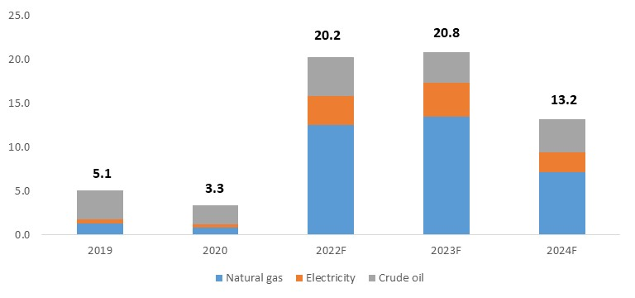
Hungary: energy import bill (EUR bn)
Source: Bloomberg, KSH

Slide 4
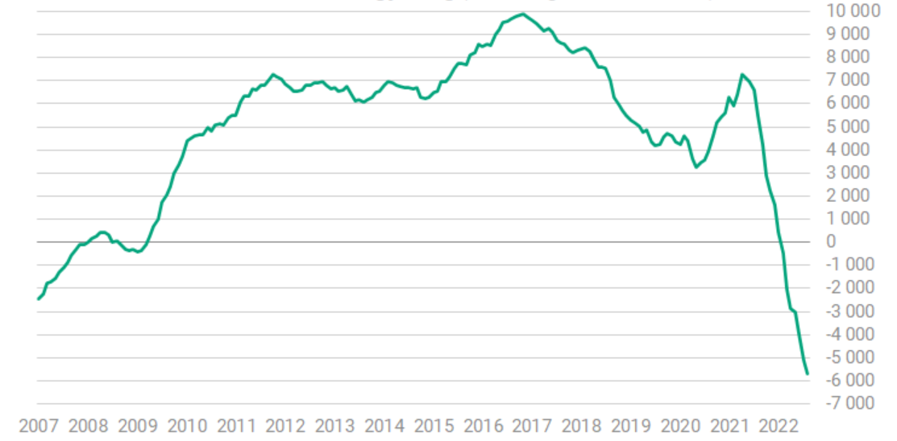
Hungary: Foreign trade deficit (12m rolling, EUR mn)
Source: Hungarian Statistical Office, Portfolio,hu

Slide 5
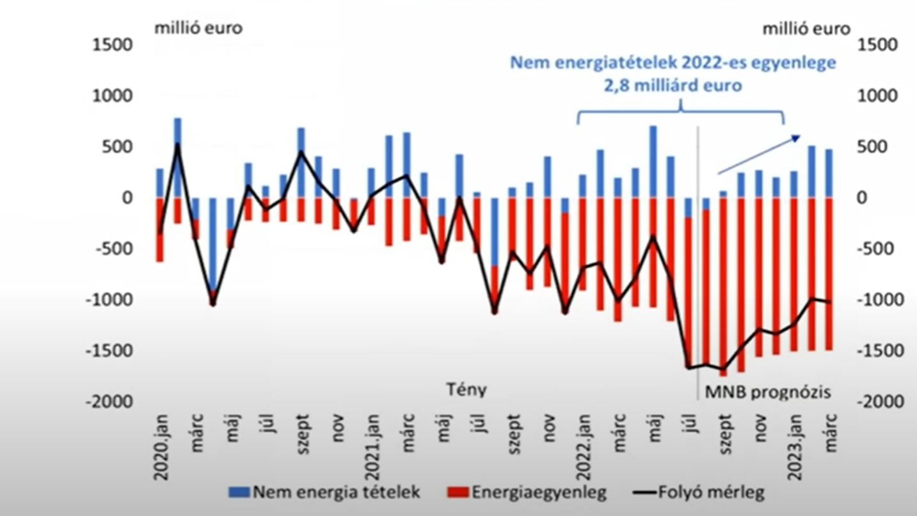
Hungary: Current account deficit (mn EUR)
Source: National Bank of Hungary

Slide 6
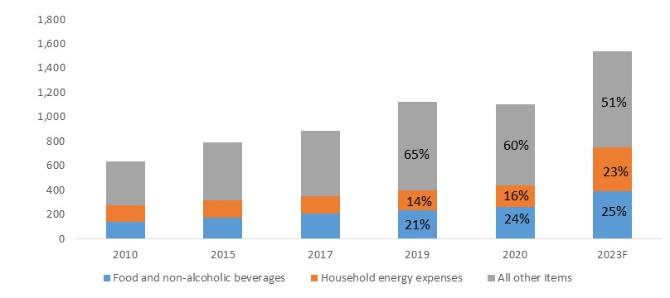
Hungary: Household expenses (HUF k/capita)
Source: Erste Group Research, Hungarian Statistical Office

Slide 7
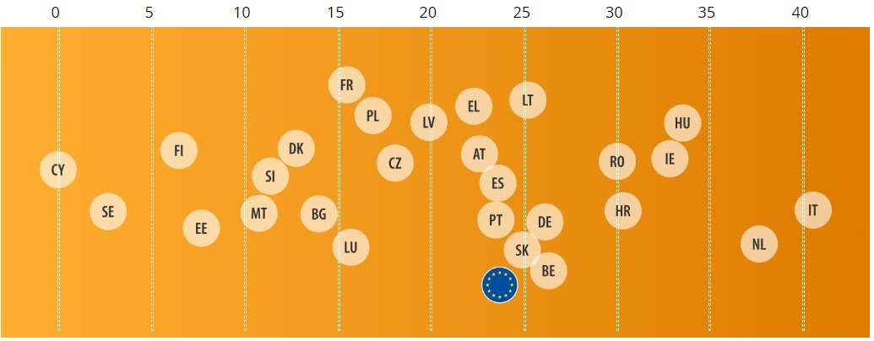
Hungary – natural gas as a primary energy source
Natural gas plays a key role in Hungary’s energy supply (%, 2020)
Source: Eurostat

Slide 8
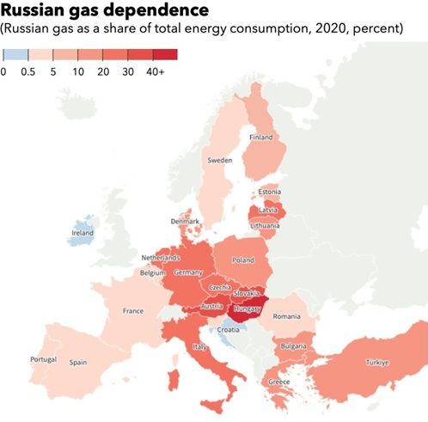
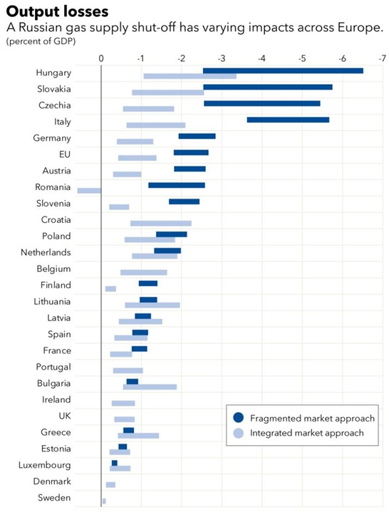
Hungary – dependence on Russian natural gas
Source: IMF

Slide 9
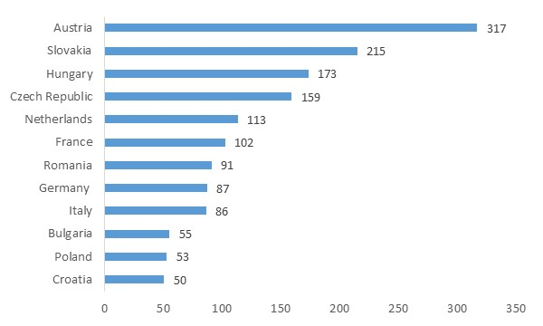
Hungary – natural gas supply outlook
How many days of average consumption stored (23 October)?
Source: AGSI

Slide 10
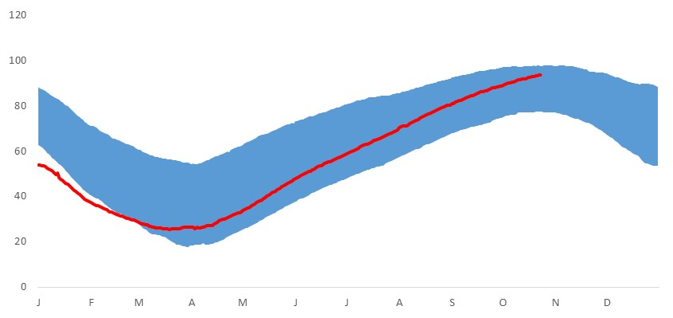
EU – storages are filled
Percentage of stored gas in EU28 vs. 5-year range (23 October 2022)
Source: Bloomberg, Erste Bank.

Slide 11
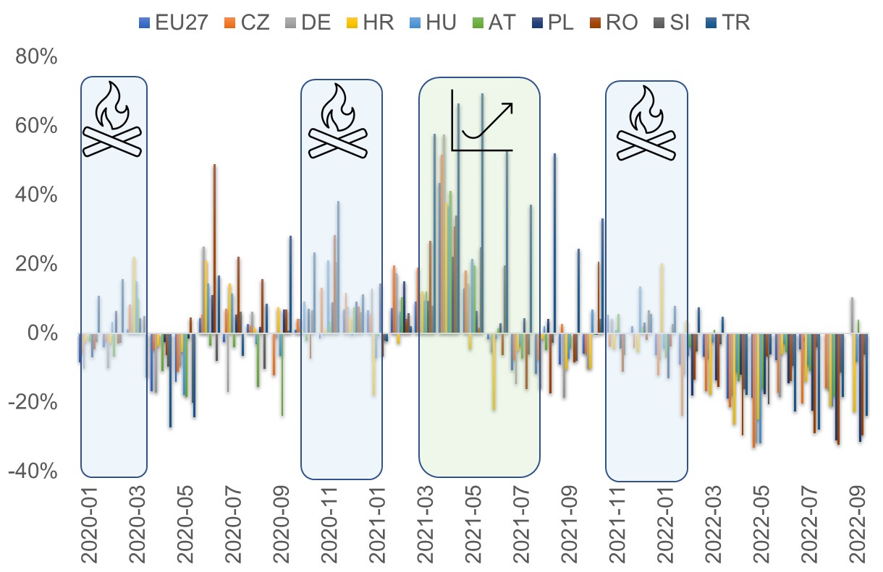
EU – natural gas consumption
EU natural gas consumption down 10.2% in 1-9M22 y/y
Source: Eurostat

Slide 12
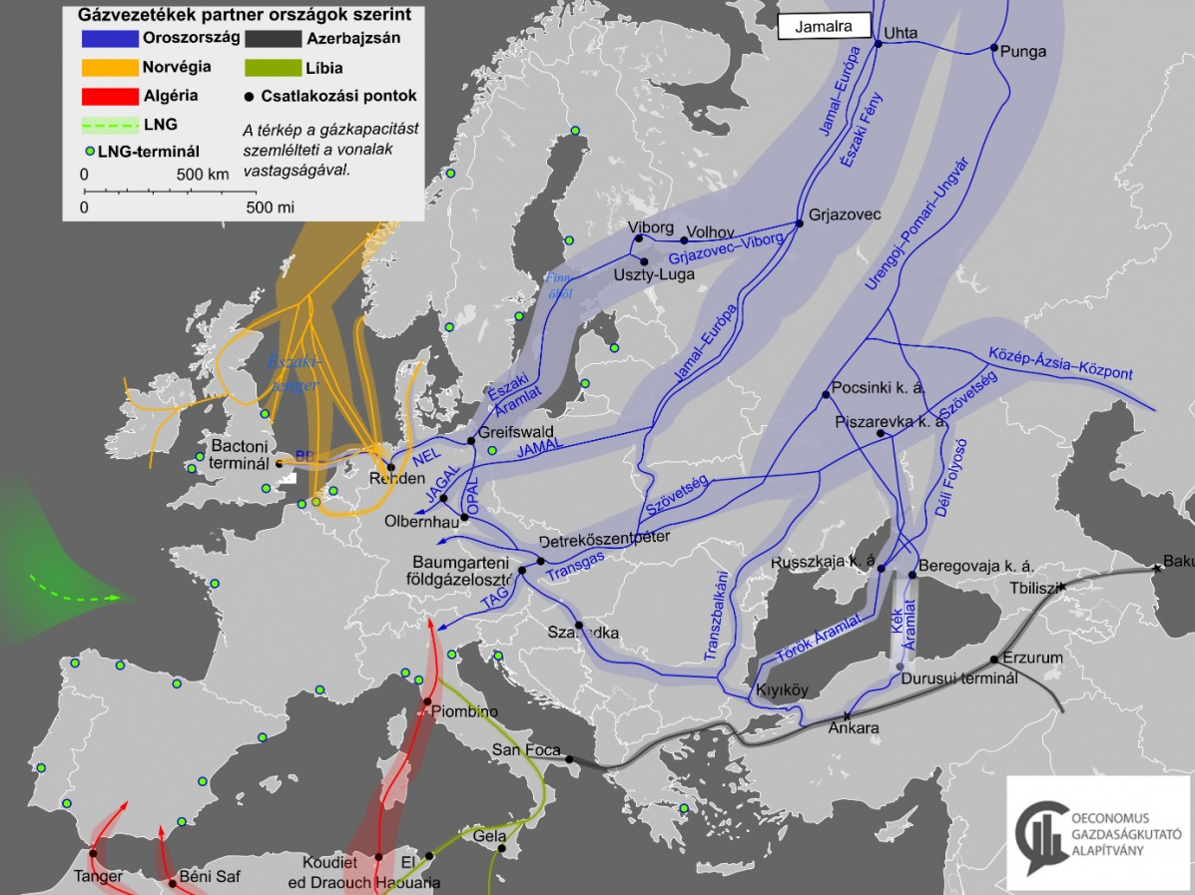
Russian gas supply to Europe
Key routes of piped natural gas to Europe (2022)

Slide 13
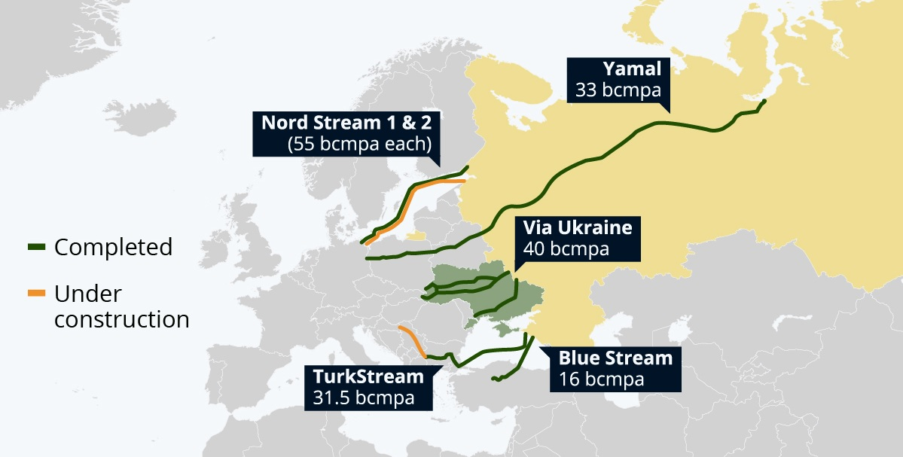
Russian gas supply to Europe
Key routes of the Russian piped gas to Europe (2021)
Source: Statista

Slide 14
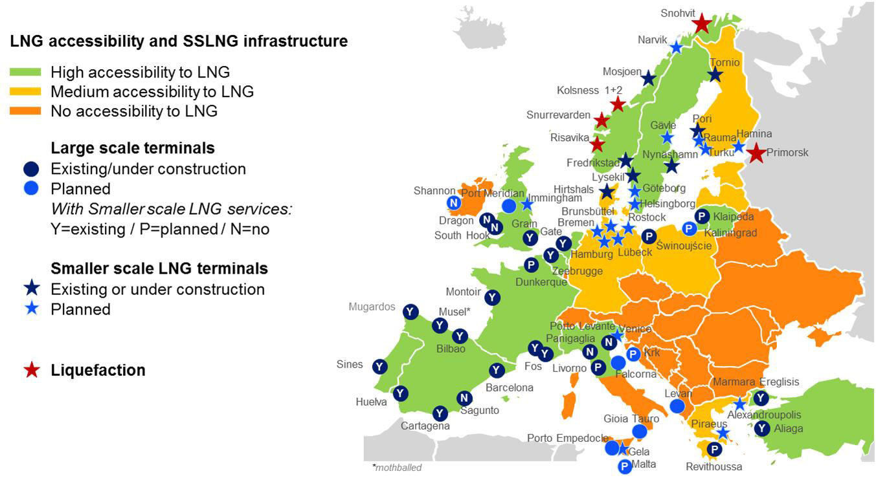
LNG – European outlook
New wave of LNG terminal building
Source: Trend.Az

Slide 15
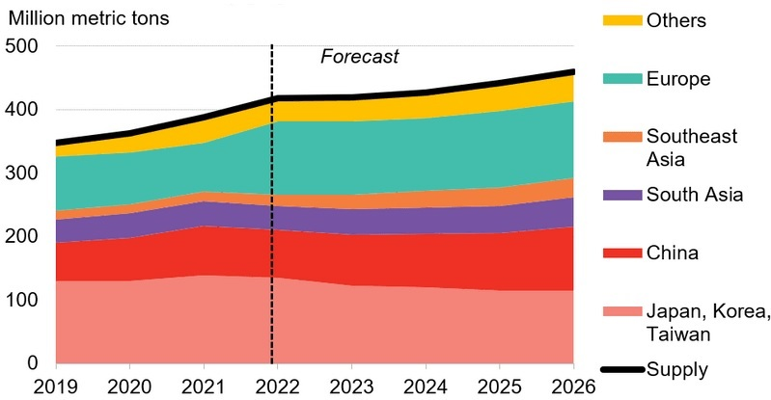
LNG – Global supply
Global supply has a limited growth until 2026
Source: Bloomberg New Finance

Slide 16
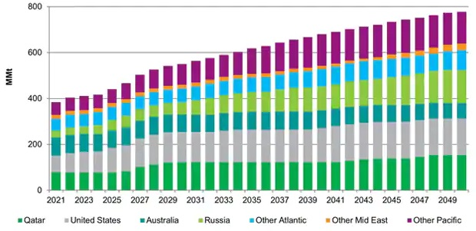
LNG – Global supply
Global supply has more upside post-2026
Source: IHS Markit

Slide 17
Summary
Hungary’s economy cannot cope with the current high prices: energy and import product consumption should be cut, economic model should be transformed
The period until mid-2024 will be tensionful, winter of 2023 will be tougher than winter 2022
The situation eases after 2026, but high energy prices remain with us this decade

Slide 18
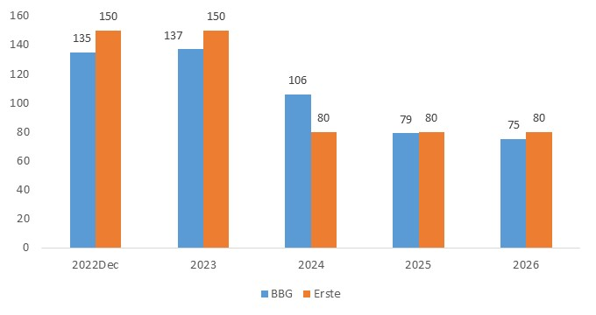
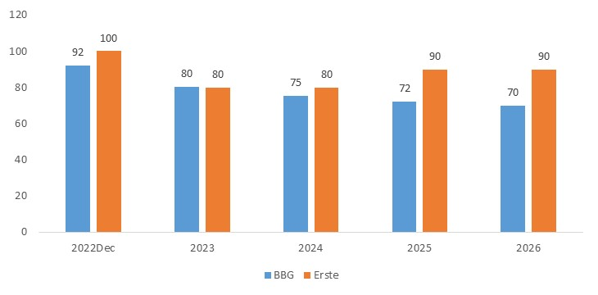
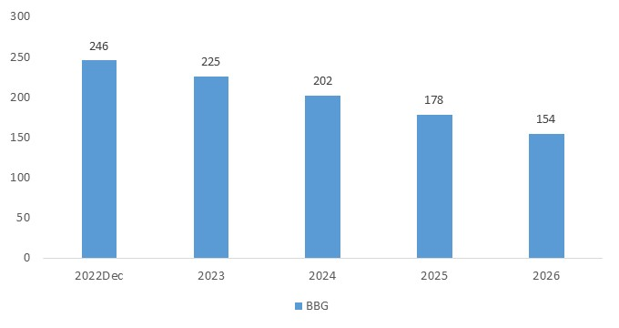
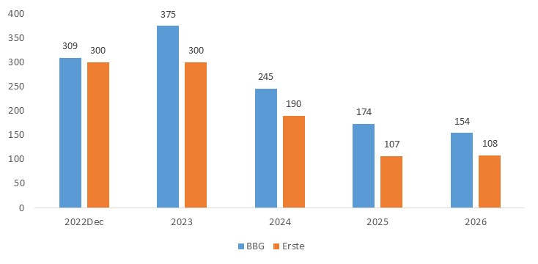
TTF day ahead forward (EUR/MWh)
North Sea Brent forward prices (USD/bbl)
South African API4 coal forward prices (USD/t)
German baseload prices (EUR/MWh)
Source: Bloomberg. 24-Oct-2022. Forward prices represent end of the year annual or monthly contract prices.

Slide 19
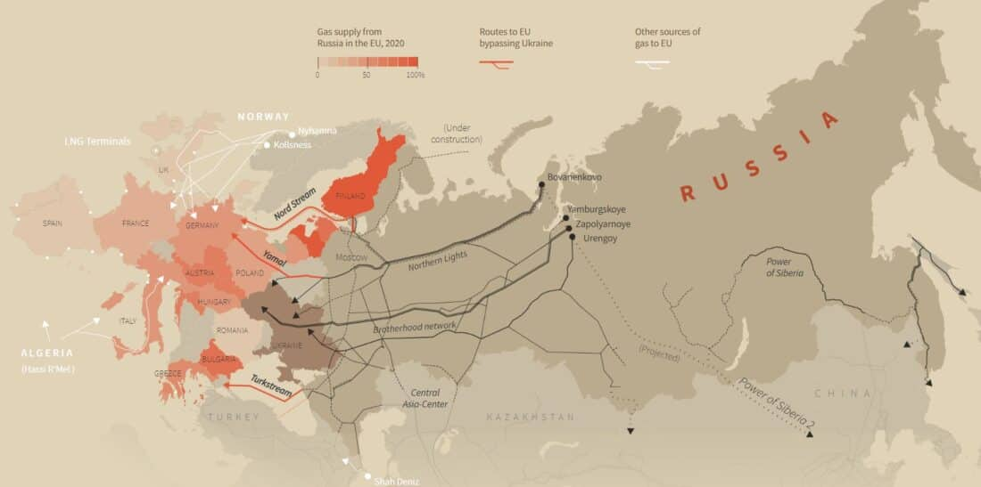
Russia: gas supply export
Natural gas pipelines of Russia (2020)
Source: ResearchGate

